Slide 1
Project report on: hospital management system
SUBMITTED BY:
ARYAN M SHIVGUNDE
(BACHELOR OF COMPUTER APPLICATION)
SUBMITTED ON:
TILAK MAHARASTHRA VIDHYAPEETH PUNE
(2024-25)
OM SAI INFOTECH

Slide 2
HOSPITAL MANAGEMENT SYSTEM

Slide 3
introduction
The Hospital Management System (HMS) is a software solution designed to manage hospital operations efficiently. It streamlines administrative tasks, enhances patient care, and facilitates better communication between hospital staff. The system integrates various modules, including patient management, appointment scheduling, billing, inventory management, and reporting. The advantages of the website is:
Doctors can view their patients’ treatment records and details easily.
It even generates an instant bill.
The system is convenient and flexible to be used.
It saves their time, efforts, money and resources.

Slide 4
System objective
The objective of creating the website is: streamline hospital workflows and administrative processes.
To digitize patient records for quick access and better management.
To improve communication between doctors, nurses, and administrative staff.
To enhance patient experience by reducing wait times and improving service delivery.
To manage hospital inventory and ensure the availability of necessary medicines and equipment.

Slide 5
System features
Patient registration and management, appointment booking
Doctor scheduling
Billing and payment processing
Inventory and pharmacy management

Slide 6
System module
The website consists of several modules are:
Admin
Patient
Doctor

Slide 7
Technologies used
Project title | Unity Hospital Website
Objectives | To provides a distinctive and engaging platform for building interactive Unity website
Front End Tool | ASP.Net
Back End Tool | C#
Tool Type of Application | Web Application

Slide 8
Database design
CREATE DATABASE Hospital_appDB;
USE Hospital_appDB;
CREATE TABLE TBLUser_info (
[UserID] INT IDENTITY NOT NULL PRIMARY KEY,
[First_name] VARCHAR (100) NOT NULL,
[Last_name] VARCHAR (100) NOT NULL,
[User_name] VARCHAR (100) NOT NULL,
[Date_of_birth] VARCHAR(100) NOT NULL,
[Gender] VARCHAR(100) NOT NULL,
[Phone_number] VARCHAR(100) NOT NULL,
[Address] VARCHAR(100) NOT NULL,
[Email] VARCHAR (100) NOT NULL,
[Password] VARCHAR (100) NOT NULL,
[Confirm_password] VARCHAR (100) NOT NULL,
);

Slide 9
CREATE TABLE TBLContact_detail (
[ContactID] INT IDENTITY NOT NULL PRIMARY KEY,
[Name] VARCHAR (100) NOT NULL,
[Email] VARCHAR (100) NOT NULL,
[Subject] VARCHAR(100) NOT NULL,
[Message] VARCHAR (100) NOT NULL,
);
CREATE TABLE Admin_detail (
[AdminID] INT IDENTITY NOT NULL PRIMARY KEY,
[First_ame] VARCHAR (100) NOT NULL,
[Last_name] VARCHAR (100) NOT NULL,
[User_name] VARCHAR (100) NOT NULL,
[Date_of_birth] VARCHAR(100) NOT NULL,
[Gender] VARCHAR(100) NOT NULL,
[Phone_number] VARCHAR(100) NOT NULL,
[Address] VARCHAR(100) NOT NULL,
[Email] VARCHAR (100) NOT NULL,
[Password] VARCHAR (100) NOT NULL,
[Confirm_password] VARCHAR (100) NOT NULL,
);

Slide 10
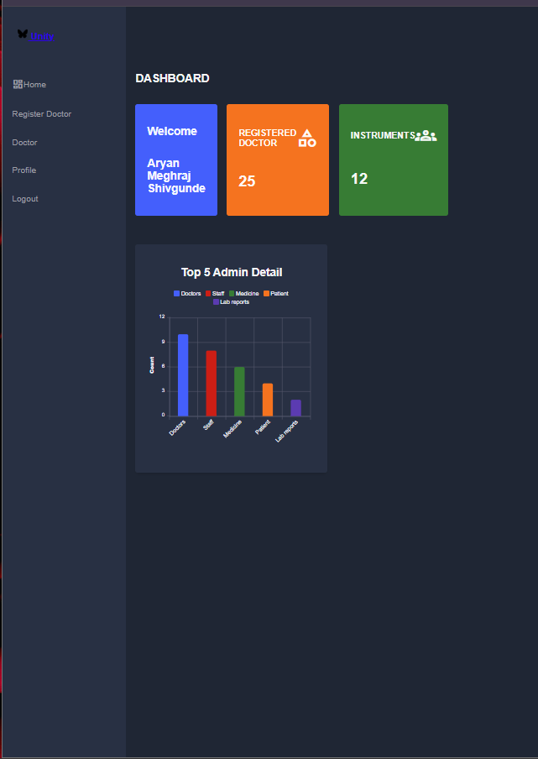
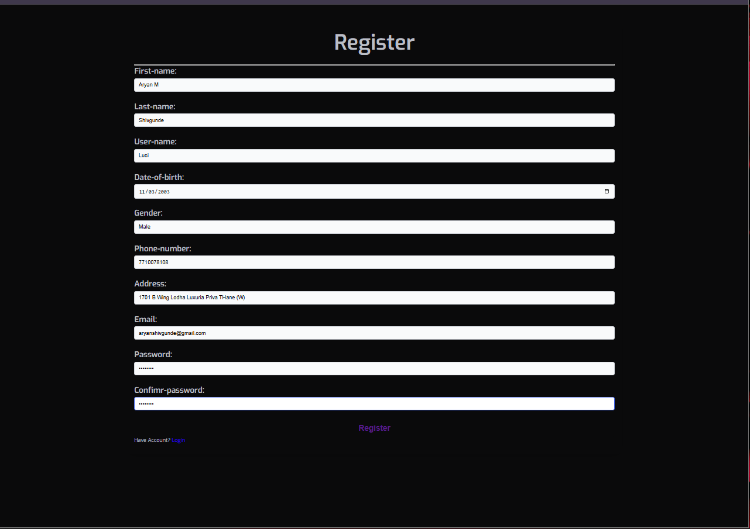
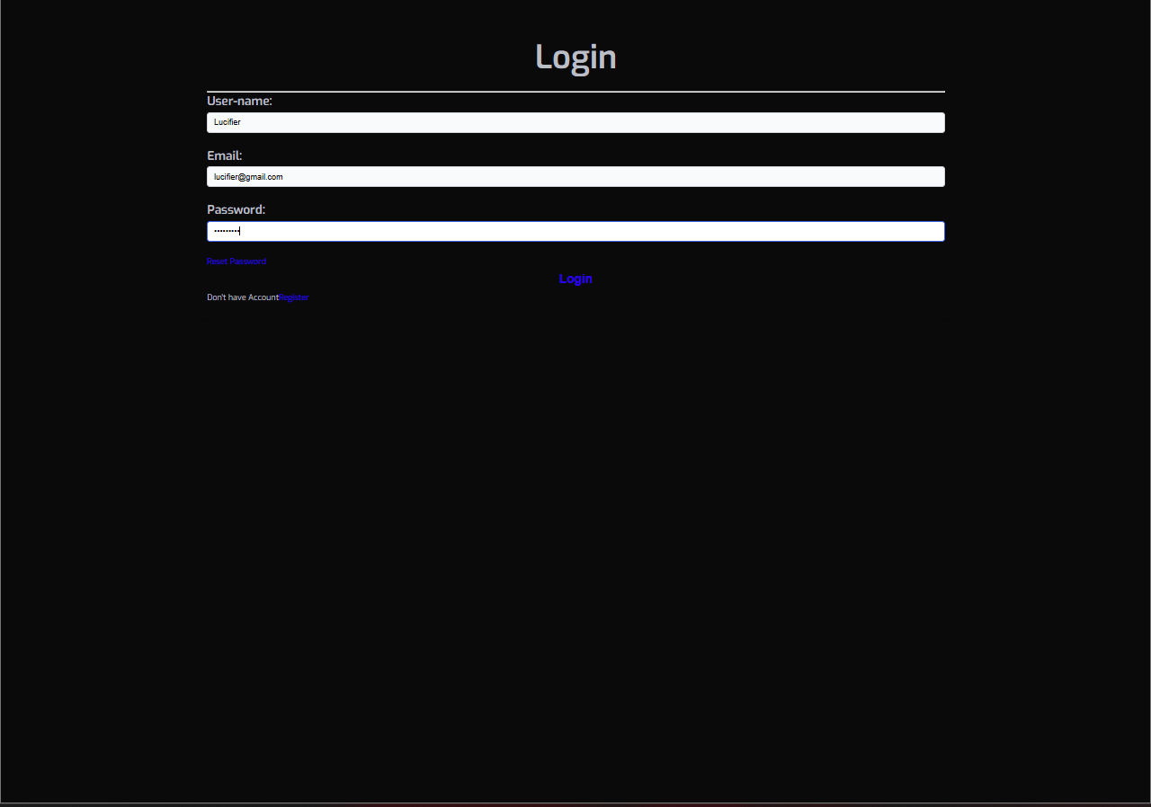

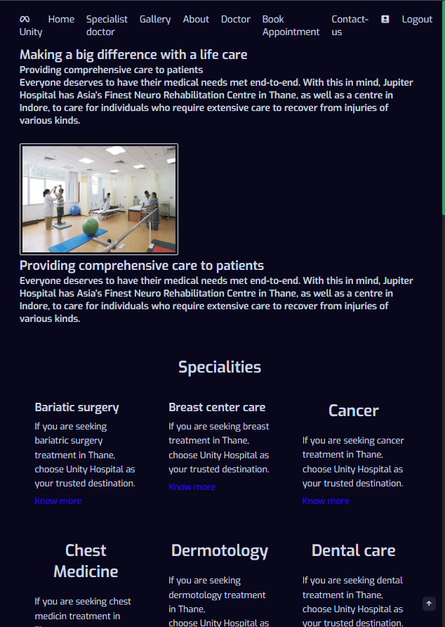

Website interface

Slide 11
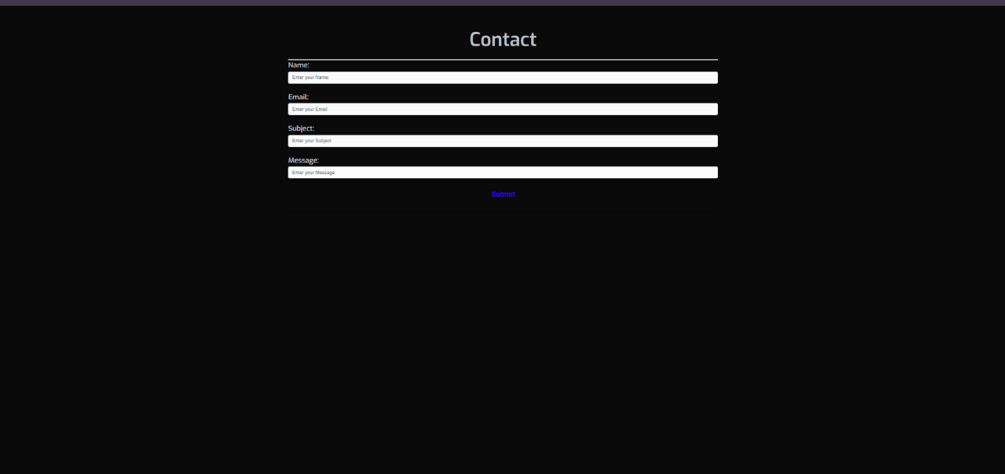
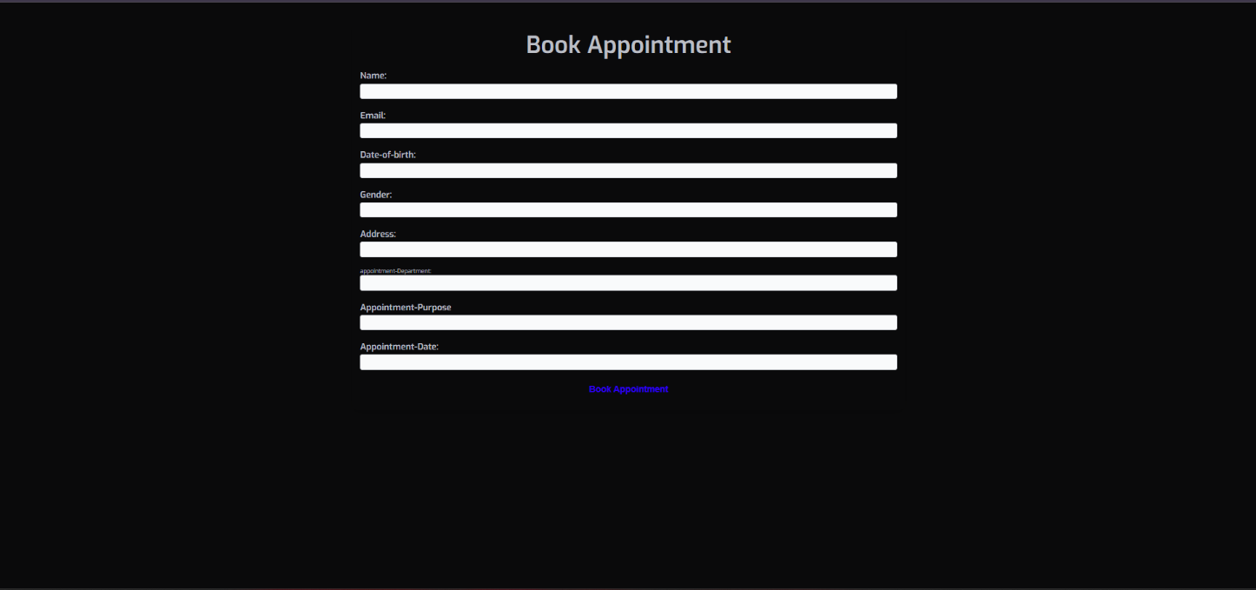
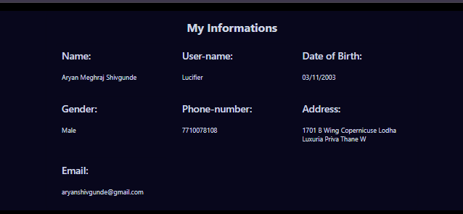
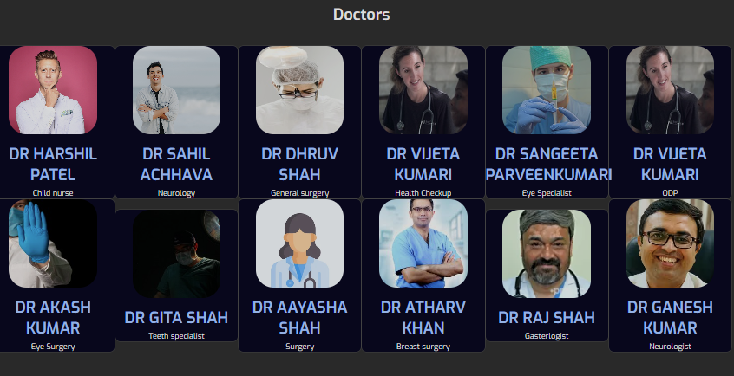
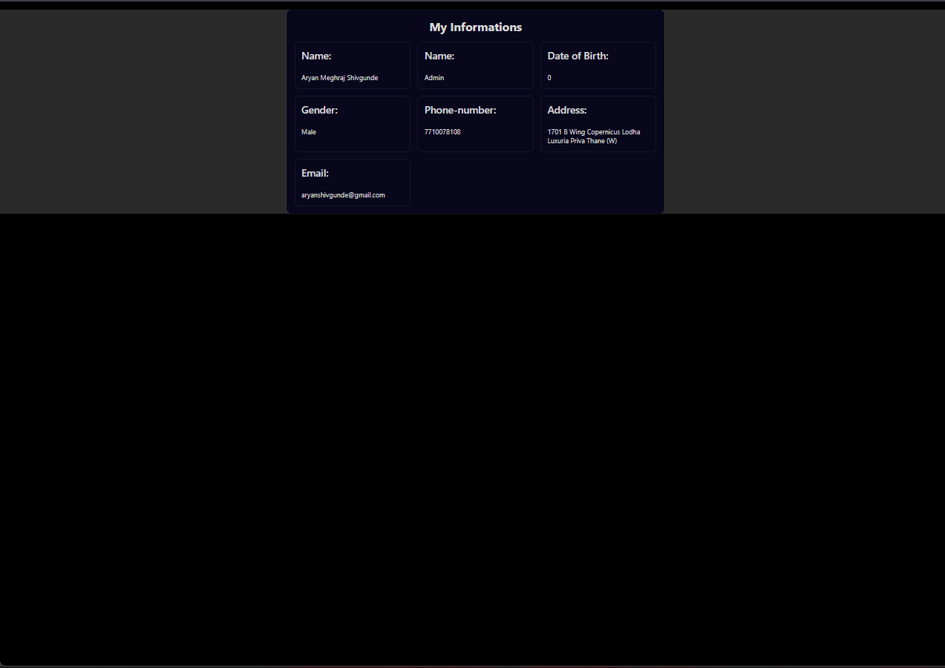

Slide 12
conclusion
1. Reflections and Recommendations: In reflecting upon the journey of designing and testing "Unity Hospital Management System Website," several key conclusions emerge, each shedding light on the application's strengths and areas for further enhancement. This conclusion encapsulates insights gleaned from the comprehensive black box testing process, offering recommendations for future iterations and user engagement strategies.
2. Automation Enhancements: One of the foremost observations is the transformative impact of automation on the system's efficiency and reliability. By streamlining processes and minimizing manual interventions, the application demonstrates heightened responsiveness and scalability. Future enhancements should prioritize further automation to optimize user experiences and backend operations seamlessly.
3. Creative User Interface: At the heart of "Unity Hospital Management System Website" lies its creative and user-friendly interface. This innovative approach to hospital management. Moving forward, continuous refinement of the interface's design and functionality will be paramount to ensure an engaging and intuitive user experience.
4. Security Considerations: While MS SQL Server offers robust security measures, it is essential to acknowledge the inherent limitations and potential vulnerabilities. While the application provides adequate security for typical usage scenarios, users are advised to exercise caution when inputting sensitive information. Adopting best practices, such as using unique passwords and refraining from sharing confidential data, mitigates potential risks and safeguards user privacy.

Slide 13
5. Authentication Mechanisms: The integration of authentication mechanisms, including email and password authentication via MS SQL services, ensures user data integrity and access control. However, users are reminded to exercise diligence in managing their account credentials and refrain from sharing sensitive information. Adopting a proactive approach to security awareness and user education will fortify the application's resilience against potential threats.
6. Future Directions: Looking ahead, the evolution of "Unity Hospital Management System Website" hinges on continuous innovation and user-centric design principles. Future iterations should prioritize enhancements in automation, user interface refinements, and security fortifications. Additionally, fostering a community-driven feedback loop and prioritizing user engagement initiatives will foster a vibrant ecosystem of “Unity Hospital Management System Website".

